Slide 1
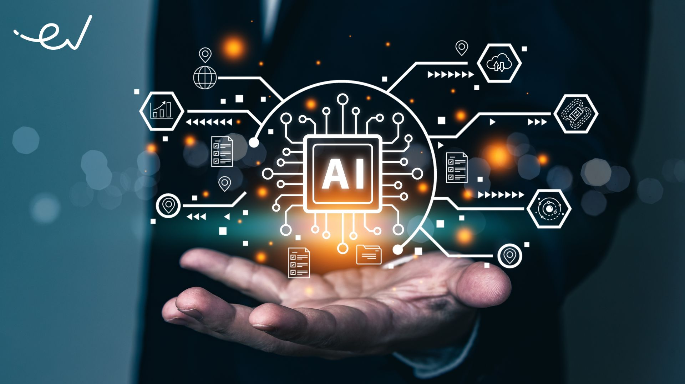

Slide 2
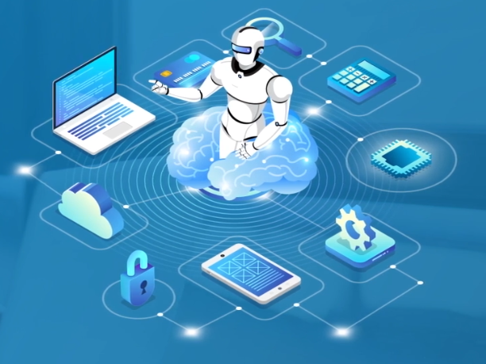
ARTIFICIAL INTELLIGENCE
ROSE MARY THOMAS
Software Engineer Trainee
KOTT Software Pvt Ltd

Slide 3



C O N C E P T
Machine Learning (ML)
Deep Learning
Types
AI
Computer Vision (CV)
Robotics & Autonomous Systems
Main
Branches
INTRODUCTION
What is AI?
Natural Language Processing (NLP)
Example
Applications

Slide 4
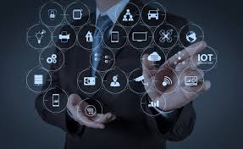
ARTIFICIAL INTELLIGENCE
Computer science the field of AI defines itself as the study of “intelligent agents”.
“Intelligent agents is a system that perceives its environment and takes actions that maximize its chances of success”
Notes:
AI is not just ChatGPT or robots. It’s a broad field in computer science about making machines simulate human intelligence.
Artificial Intelligence (AI) is the branch of computer science that focuses on creating machines and software capable of performing tasks that usually require human intelligence. It aims to simulate human cognitive abilities such as learning, reasoning, problem-solving, perception, and language understanding.
Key Characteristics of AI
Learning – Machines improve their performance based on experience (e.g., Machine Learning algorithms).
Reasoning – Machines make decisions and solve problems logically.
Perception – Machines interpret sensory data (images, sounds, touch).
Natural Language Processing (NLP) – Machines understand and respond to human language.
Autonomy – Machines perform tasks without constant human guidance.
Types of AI
Based on Capability
Narrow AI (Weak AI) – AI specialized in one task (e.g., Siri, Google Translate).
Designed to perform specific tasks.
Examples: Chatbots, image classifiers, recommendation systems.
{{Agentic AI fits here, as it's tailored for specialized domains but with added autonomy and adaptability.
Agentic AI is best categorized as a form of Narrow (or Specialized) AI, but it's uniquely powerful—it’s more autonomous, goal-driven, and adaptable than traditional narrow AI systems.}}
General AI (Strong AI) – AI that can perform any intellectual task like a human (still theoretical).
Super AI – AI surpassing human intelligence (speculative future concept).
Intelligence surpassing human levels in all domains.
Remains a speculative concept far beyond current technologies.
Based on Functionality
• Reactive Machines / Traditional AI
Operate on predefined rules or respond to inputs (e.g., simple classifiers).
No autonomy or long-term planning.
• Limited Memory AI
Use recent past data to inform actions (e.g., self-driving cars).
Some autonomy—but still constrained.
• Agentic AI
Exhibits real autonomy, planning, execution, and learning.
Orchestrates multi-step goals, interacts with tools/APIs, and adapts based on results
• Theory of Mind / Self-Aware AI
Still theoretical; not realized yet.
Intro
I'm going to attempt to classify all of artificial intelligence or AI into seven types. And that's
a tall order. But these seven types of AI can largely be understood by examining two
encompassing categories. There's AI capabilities, and there's AI functionalities. So let's start
with AI capabilities, and there are three. The first of which is known as artificial narrow AI,
which also goes by the rather unflattering name of "weak AI". Now, on its face, that doesn't sound like
Narrow AI
a very interesting capability to start us off. But actually, narrow AI is the only type of AI
that exists today--it's all we currently have. Any other form of AI is theoretical. So we can think
Theoretical AI
of this as realized AI--that's the artificial intelligence we have today. And theoretical AI,
which is the artificial intelligence we may have in the future. And now narrow AI can be trained
to perform a narrow task, which, to be fair to narrow AI, might be something that a human
could not do as well as the AI can. But it can't perform outside of its defined task. It does need
us humans still to train it. So if narrow AI represents all AI capabilities we have today,
well, what else is there? Well, a favorite of memes, science fiction, and betting markets is
artificial general intelligence, also known as AGI. And also known as "strong AI". To be clear,
General AI
AGI is currently nothing more than a theoretical concept. But here's the idea: AGI can use previous
learnings and skills to accomplish new tasks in a different context, without the need for
us human beings to train the underlying models. If AGI wants to learn how to perform a new task,
it will figure it out by itself. Which sounds... disconcerting. But, but look,
we haven't even talked about the third type of AI capability yet. And that's artificial "super AI". If
Super AI
ever realized, super AI would think, reason, learn, make judgments and possess cognitive
abilities that surpass those of human beings. The application's [possessing] super AI capabilities
would have evolved beyond the point of catering to humans sentiments and experiences, and would be
able to feel emotions and have needs and possess beliefs and desires of their own. Yeah. So let's
park that cheery thought for now, and consider the four types of AI based on functionalities.
And we're back in the real world of realized AI here--at least initially. So we can think
of narrow AI as having two fundamental functions. One of those is reactive machine AI.
Reactive AI
Now reactive machine AI are systems designed to perform a very specific specialized task. Reactive AI stems from
statistical math, and it can analyze vast amounts of data to produce a seemingly intelligent output.
We've had reactive AI for quite a long time. Back in the late 1990s, IBM's chess playing supercomputer
Deep Blue beat chess grandmaster Garry Kasparov by analyzing the pieces on the board and predicting
the probable outcomes of each move. That's a specialized task with a lot of available data
to create insights. The hallmark of reactive AI. We can think of other narrow AI functionalities
really as being classified as "limited memory AI". Now this form of AI can recall past events
Limited Memory AI
and outcomes and monitor specific objects or situations over time. It can use past and present
moment data to decide on a course of action most likely to help achieve a desired outcome. And as
it's trained on more data over time, limited memory AI can improve in performance. Think of
your favorite generative AI chatbot, which relies on limited memory AI capabilities to predict the
next word or the next phrase or the next visual element within the context it's generating. Okay,
so what about our two theoretical AI capabilities? Well, if we look at AGI, we have to think about
"theory of mind AI". Now, this would understand the thoughts and emotions of other entities,
Emotion AI
specifically us, so it could infer human motives and reasoning and personalize its interactions
with individuals based on their unique emotional needs and intentions. And actually, emotion AI
is a theory of mind AI currently in development. AI researchers hope it will have the ability to
analyze voices, images and other kinds of data to understand and respond to human feelings.
Finally! An AI that really understands me. And then finally, under super AI, we have "self-aware
Self Aware AI
AI". Winning my personal award for the scariest AI of all, it would have the ability to understand
its own internal conditions and traits, leading to its own set of emotions, needs and beliefs. Look,
we've covered seven types of AI, and only three of them actually exist today! There is still so
much to be learned and discovered. But as those advancements happen, at least here we
have a taxonomy of AI types that will tell us how far along we are on our AI journey.

Slide 5
AGENTIC AI
Agentic AI is an autonomous artificial intelligence system capable of making decisions and performing complex tasks with minimal human intervention.
It consists of AI agents that perceive, reason, act, learn, and collaborate to achieve specific goals independently, adapting in real-time to new information and obstacles.
Agentic AI is an artificial intelligence system that can accomplish a specific goal with limited supervision. It consists of AI agents—machine learning models that mimic human decision-making to solve problems in real time. In a multiagent system, each agent performs a specific subtask required to reach the goal and their efforts are coordinated through AI orchestration.

Slide 6
EXAMPLE:
In KEKA assistant :
Onboard the new intern joining next Monday
Step 1: Schedule welcome meeting
Step 2: Create intern’s profile in Keka system
Step 3: IT Helpdesk (wifi credentials, email,slacle sccess
Step 4: Order laptop, ID card

Slide 7
Generally, the term “AI” is used when a machine simulate functions that human’s associate with other human minds such as learning and problem solving.
Learn
Recognize
Act
Notes:
three core capabilities of AI: Learn, Recognize, Act. Let’s break this down in a simple but thorough way.
1. Learn 🧠
AI systems learn from data and experiences — just like humans learn from examples. Instead of being explicitly programmed for every rule, the AI adjusts itself based on the patterns it finds.
Example:
You give an AI 10,000 pictures of cats and dogs, labeled as “cat” or “dog.”
The AI learns patterns: cats often have pointy ears, dogs have longer snouts.
In ML/DL terms → This is model training.
Technical Side:
Involves training algorithms (e.g., Neural Networks, Decision Trees).
Uses datasets (training data) to adjust internal parameters (weights).
2. Recognize 👀
Once trained, the AI must recognize patterns, objects, or situations in new, unseen data.
Example:
You show it a new picture it’s never seen.
It recognizes: “That’s a cat!” with 92% confidence.
This is inference — using what it learned to identify things.
Technical Side:
Involves pattern recognition — finding similarities with what it has learned.
Can be:
Image recognition (faces, objects)
Speech recognition (voice commands)
Text recognition (spam detection)
3. Act 🤖
AI doesn’t just identify — it can take actions based on what it recognizes.
Example:
Self-driving car detects a pedestrian (recognition).
AI decides to brake immediately (action).
In reinforcement learning, this is called policy execution.
Technical Side:
Involves decision-making systems (rule-based or learned).
May use:
Control systems (robotics, cars)
Automation scripts (chatbots sending replies)
API calls (an agent booking your flight)
Putting It All Together:
Think of a self-driving car:
Learn – Trained with millions of miles of driving data.
Recognize – Identifies road signs, pedestrians, other cars.
Act – Accelerates, brakes, or changes lanes.

Slide 8
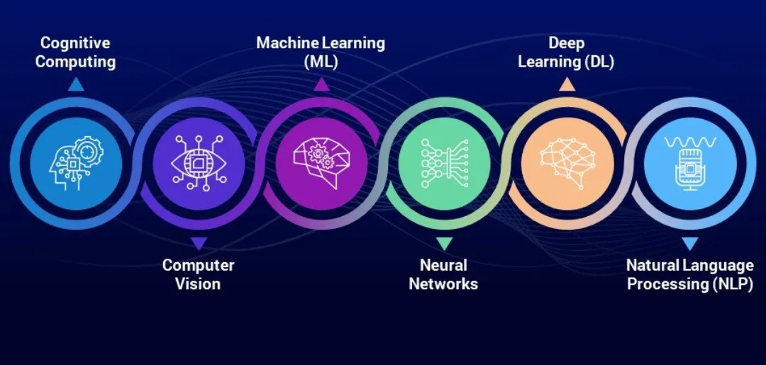
BRANCHES
Notes:
Main branches:
Machine Learning (ML) – systems learn patterns from data.
Deep Learning – neural networks for vision, language, speech.
Natural Language Processing (NLP) – making computers understand text/speech.
Computer Vision (CV) – making computers see & understand images/videos.
Robotics & Autonomous Systems – physical AI in machines.
Artificial Intelligence (AI)
Definition: Broad field focused on simulating human intelligence in machines.
Goal: Enable computers to perform tasks that typically require reasoning, learning, and decision-making.
History: Started with early systems like Lisp/Prolog programs, later expert systems (1980s–90s).
Machine Learning (ML)
Subset of AI: Machines learn from data instead of being explicitly programmed.
Key Idea: Algorithms find patterns and make predictions or decisions.
Types:
Supervised Learning → trained with labeled data.
Unsupervised Learning → finds patterns without labels.
Reinforcement Learning → learns by interacting with environment & feedback.
Applications: Predictions, anomaly detection, cybersecurity, fraud detection.
Deep Learning (DL)
Subset of ML: Uses multi-layered neural networks.
Strengths: Handles vast amounts of unstructured data (images, speech, text).
“Deep” = multiple hidden layers between input & output.
Challenge: Hard to interpret why models make certain decisions (“black box”).
Foundation Models (FMs)
Subset of Deep Learning: Large-scale neural networks trained on huge datasets.
Purpose: Serve as a “foundation” for many tasks—fine-tuned for specific use cases.
Examples:
LLMs (Large Language Models) → text-based (chatbots, translation, writing).
Vision Models → interpret/generate images.
Audio Models → generate speech/music.
Scientific Models → protein folding, biology, research tasks.
Impact: Saves time/resources compared to training new models from scratch.
Large Language Models (LLMs)
Type of Foundation Model: Specialized in language.
“Large” → billions of parameters.
Capabilities: Understand grammar, context, idioms, culture.
Uses: Q&A, translation, creative writing, summarization, chatbots.
Generative AI (GenAI)
Definition: AI systems designed to generate new content (text, images, audio, video).
Examples: Chatbots (ChatGPT), deepfakes, music/speech generators.
Debate: Some argue it just “repackages” existing info—but like music (same notes in new order), it creates new combinations.
Risks & Uses: Entertainment, accessibility, productivity—but also misuse (fake voices, misinformation).
Overall Evolution
AI (broad) → simulating intelligence.
ML → learning patterns from data.
DL → powerful neural networks for complex tasks.
Foundation Models → large-scale pre-trained models for many applications.
Generative AI → creative, content-producing AI (chatbots, deepfakes, etc.).

Slide 9
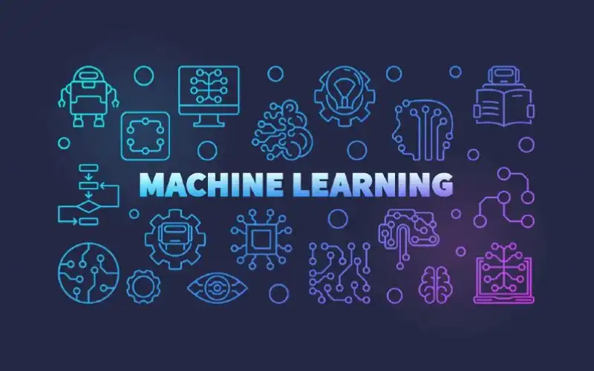
Notes:
Machine Learning is a branch of AI where computers learn patterns from data instead of being explicitly programmed for every rule.
At its heart, Machine Learning is about approximating a function that maps inputs (features) to outputs (labels).
Instead of telling the computer:
If salary > 50000 and credit_score > 700 then approve loan
You give it examples of past loan approvals & rejections, and it figures out the rules by itself.
Mathematically:
Y=f(x)+e
x → Input features (e.g., size of house, number of bedrooms)
y → Output/label (e.g., house price)
f → The function/model we are trying to learn
ϵ\epsilonϵ → Error/noise
Goal → Find the best fsuch that predictions are as close as possible to real outcomes.

Slide 10
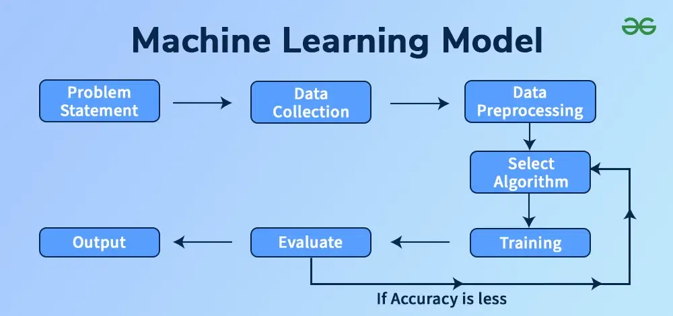
Notes:
2. How ML Works (in 4 Steps)
Collect Data – e.g., a CSV of housing prices, patient symptoms, or stock movements.
Train a Model – Feed the data into an algorithm so it learns patterns.
Test the Model – Give it new, unseen data to check accuracy.
Predict – Use the trained model to make future predictions.
2. ML Pipeline
Every ML project (no matter the domain) follows roughly the same steps:
Step 1: Problem Definition
Is it classification (predict category) or regression (predict number)?
Example:
Classification: “Will this email be spam or not?”
Regression: “What will be the house price?”
Step 2: Data Collection
Gather raw data from files, databases, APIs, or sensors.
Example: Housing dataset from Kaggle.
Step 3: Data Preprocessing
Cleaning: Handle missing values, remove duplicates.
Feature Engineering: Create useful new variables.
Scaling/Normalization: Standardize features for better training.
Encoding: Convert categorical data into numbers (One-Hot Encoding, Label Encoding).
Step 4: Model Selection
Choose an algorithm:
Linear Models: Linear Regression, Logistic Regression
Tree-based: Decision Trees, Random Forest, XGBoost
Neural Networks: Deep Learning
Step 5: Training
Split data: Train set (~70-80%) & Test set (~20-30%).
The model learns patterns from the training set.
Step 6: Evaluation
Compare predictions to actual results.
Metrics:
Regression: MAE, MSE, RMSE, R²
Classification: Accuracy, Precision, Recall, F1-score, ROC AUC
Step 7: Deployment
Save the trained model.
Use it in production (API, web app, embedded system).

Slide 11

Notes:
3. Types of Machine Learning
A. Supervised Learning (most common)
Data has labels (answers already known).
Examples:
Predict house prices (Regression)
Classify emails as spam/not spam (Classification)
Algorithms: Linear Regression, Decision Trees, Random Forest, Neural Networks.
· Labeled data (input + correct output)
is labeled, meaning that the algorithm identifies the features explicitly and carries out predictions or classification accordingly. As the training period progresses, the algorithm is able to identify the relationships between the two variables such that we can predict a new outcome.
As the training period progresses, the algorithm is able to identify the relationships between the two variables such that we can predict a new outcome.
Supervised learning is the one, where we can consider the learning is guided by a teacher. We have a labeled dataset which acts as a teacher and its role is to train the model or the machine. Once the model gets trained it can start making a prediction or decision when new data is given to it. As because supervised learning relies on predefined classes and class-labeled training examples, it is often described as learning by examples.
Some of the important algorithms that come under Supervised Learning are given below:
Artificial Neural Network (ANN)
Support Vector Machine (SVM)
Decision Tree (DT)
K-Nearest Neighbor (KNN)
Random Forest
Linear Regression
Logistic Regression
Gradient Boosted Trees (XGBoost, LightGBM)
· Examples:
Predict movie ratings (regression)
Classify tumors as malignant/benign (classification)
B. Unsupervised Learning
Data has no labels — the AI finds patterns by itself.
Examples:
Group customers into segments
Cluster similar news articles
Algorithms: K-Means Clustering, Hierarchical Clustering.
· Unlabeled data (only input, no output)
· AI finds patterns/structure
· Examples:
Customer segmentation (K-Means)
Market basket analysis (Apriori)
· Algorithms:
Clustering: K-Means, DBSCAN
Dimensionality Reduction: PCA, t-SNE
C. Reinforcement Learning
AI learns by trial and error with rewards & penalties.
Examples:
Self-driving cars
Game-playing bots (Chess, Go, Atari)
· Agent interacts with environment
· Receives rewards/penalties for actions
· Examples:
Self-driving cars
Game-playing bots
· Key elements:
Agent
Environment
Reward function
Policy (mapping states to actions)

Slide 12
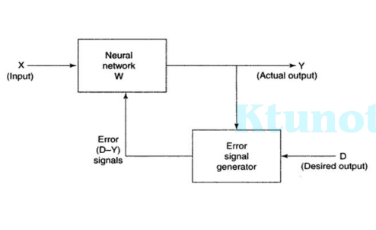
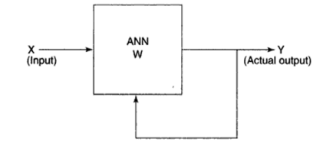
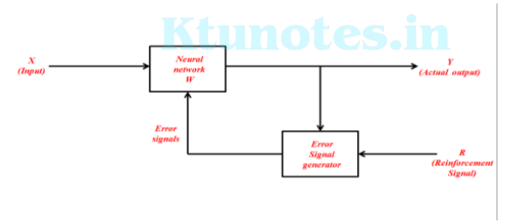

Slide 13
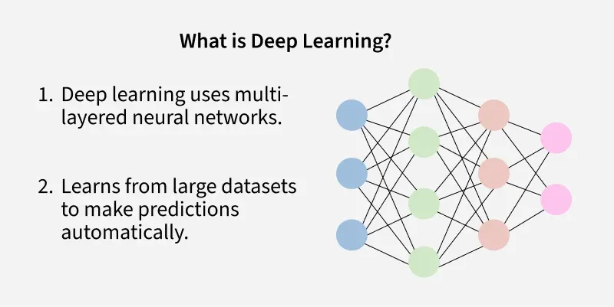
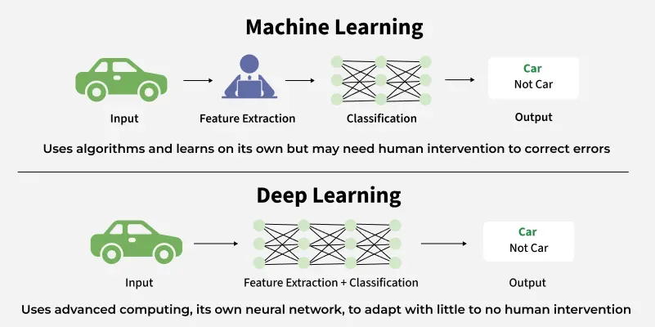
Notes:
Deep Learning
1. What is Deep Learning?
Deep Learning is a subset of Machine Learning that uses neural networks with many layers (hence “deep”) to automatically learn complex patterns from data.
Think of it like this:
Machine Learning → You give the algorithm features (manually selected).
Deep Learning → The algorithm learns the features itself from raw data.
Example:
ML: Detect a cat by giving ear length, eye shape, fur color.
DL: Feed it raw cat images — it figures out those features on its own.
What is Deep Learning?
A subset of Machine Learning that uses artificial neural networks with many layers.
Inspired by the way the human brain processes information.
· Why important?
Powers technologies like self-driving cars, speech recognition, medical diagnosis, and chatbots.

Slide 14
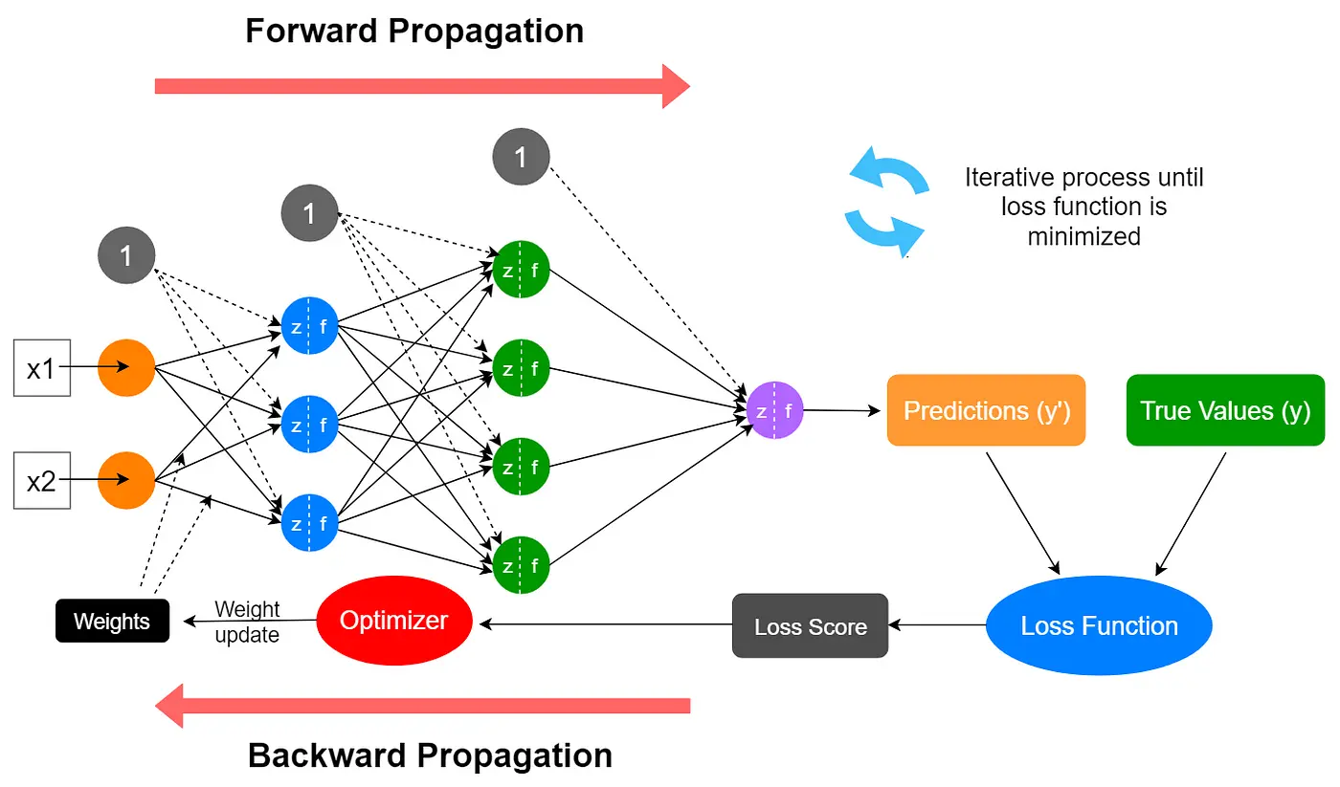
HOW DOES NEURAL NETWORK WORKS?
Notes:
This image explains how a neural network works through the processes of forward propagation and backward propagation.
Forward Propagation
Inputs (x1, x2): The neural network receives input values, which are passed to the input layer.
Hidden Layers: The input data moves through several hidden layers (represented by colored circles), where each layer transforms the data using weights and activation functions.
Predictions (y'): The final output of the network after passing through all layers is called the prediction.
Loss Function and Score
True Values (y) vs. Predictions (y'): The network compares its predictions to true values.
Loss Function: The difference (error) between the true value and the prediction is calculated using a loss function. This outputs a loss score.
Backward Propagation (Training the Network)
Optimizer: The optimizer uses the loss score to adjust (update) the network's weights and biases.
Iterative Process: This process (forward propagation → loss calculation → backward propagation/optimizer) repeats iteratively, updating the weights each time, until the loss function is minimized and the network’s predictions become as accurate as possible.
Key Points in the Diagram
Red Arrows: Forward and backward propagation directions.
Loops: Indicates the process is repeated multiple times (epochs) for learning.
Optimizer: Central to tuning the network based on error signals.
3. How a Neural Network Learns
Forward Pass – Data flows from input to output, producing a prediction.
Loss Calculation – Compare prediction to the actual answer.
Backward Pass (Backpropagation) – Adjust weights to minimize error.
Optimization – Use algorithms like Gradient Descent to update weights.
Mathematically:
Net input Yin = x1w1+x2W2
Y=f(yin)
Output = funtion(net input)
Yin= x1w1+x2w2+x3w3+ …………xmwm
Net input yi = \sum_{i}^{m} xi.wi
Y = F(yin)
If have bias
Yin=b+sum of xi*wi
4. Activation Functions
Activation functions decide how much signal passes through a neuron:
Activation function may be defined as the extra force or effort applied over net input to obtain an exact output.
Liner and non liner activation functions can be used to generate the neurons response
Linear ► Identity functions ► Binary Step Function ► Bipolar step functions
Non Linear ► Sigmoid Function ► Ramp Function
Sigmoid: Good for probabilities
ReLU (Rectified Linear Unit): Most common in hidden layers
Softmax: For multi-class classification
5. Why Deep Learning Works Well
Handles large, complex datasets
Learns directly from raw data (images, audio, text)
Powers state-of-the-art AI in:
Image recognition (Computer Vision)
Speech recognition
Natural language processing (GPT, BERT)
Game-playing bots (AlphaGo)
Connections
Single layer feed forward network
Multi layer feed forward network
Single node with its own feedback
Single layer recurrent network
Multi layer recurrent network
6. Popular Architectures
Feedforward Neural Networks (FNN) – Basic fully connected layers.
Convolutional Neural Networks (CNN) – For images & vision.
Recurrent Neural Networks (RNN, LSTM, GRU) – For sequences like text/audio.
Transformers – Modern NLP models (GPT, BERT, etc.).
GANs (Generative Adversarial Networks) – For generating data (images, music).
7. Deep Learning Workflow
Collect Data (e.g., images, text, audio)
Preprocess Data (resize, normalize, tokenize)
Build Model (choose architecture)
Train Model (forward pass + backpropagation)
Evaluate Model
Deploy Model

Slide 15
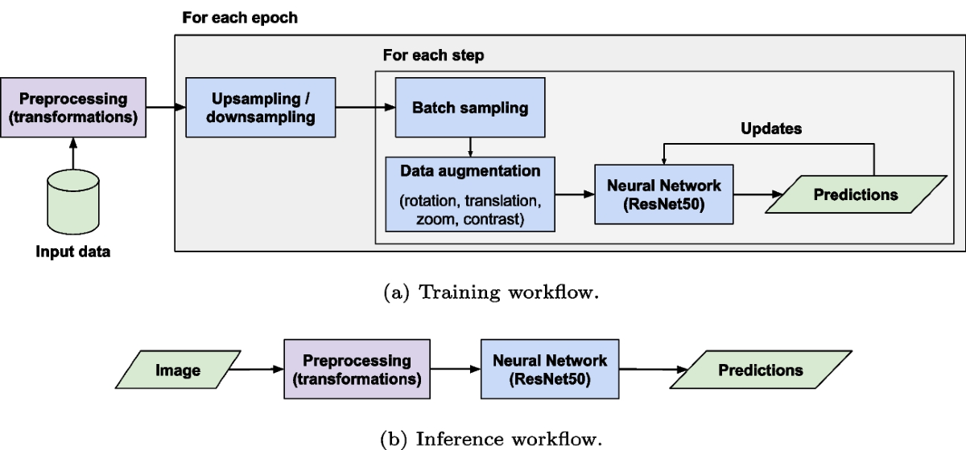
Notes:
This image explains the difference between the training workflow and the inference workflow for a neural network model, specifically using ResNet50 (a common deep learning image model).
Training Workflow (a) refers to the process where a neural network is actively learning from data:
Purpose: The goal is to teach the neural network how to make accurate predictions by adjusting its internal parameters (weights and biases).
Inference Workflow (b) is the process used after training, when the model is used for making predictions on new, unseen data:
Purpose: To apply the trained neural network to new images or input data and obtain predictions.
Training Workflow (a)
Input Data: Raw data images are the starting point.
Preprocessing (transformations): Initial cleaning and formatting (e.g., resizing, normalization).
Upsampling/Downsampling: Adjusts the number of samples to balance classes if needed.
Batch Sampling: Splits the data into smaller batches for efficient training.
Data Augmentation: Applies random transformations (rotation, translation, zoom, contrast) to make the model robust to real-world variations.
Neural Network (ResNet50): The processed images are fed into the neural network, which makes predictions.
Updates: Model weights are adjusted based on predictions versus expected outcomes, repeating for many steps and epochs.
Inference Workflow (b)
Image: A new image is provided for prediction.
Preprocessing (transformations): The same transformations used as during training are applied here.
Neural Network (ResNet50): The preprocessed image is passed through the trained network.
Predictions: The model outputs its predictions (e.g., classifying what's in the image).
Key Point
Training: Involves multiple steps like augmentation, sampling, and iterative updates.
Inference: Is simpler, needing just preprocessing before passing the image to the trained model for prediction.

Slide 16
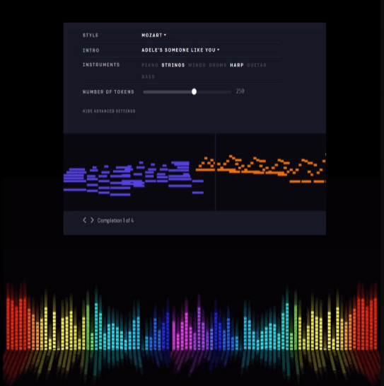
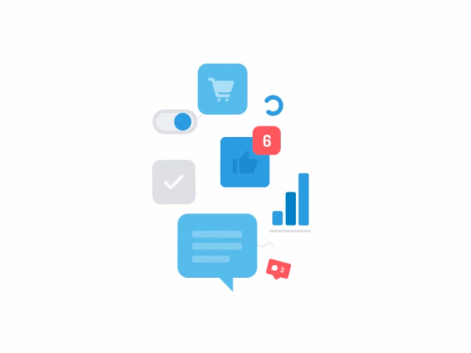
10. AI IN ARTIFICIAL CREATIVITY
MuseNet
MuseNet, a deep neural network that can generate 4- minute musical compositions with 10 different instruments.
Wordsmith
Wordsmith is an AI- powered tool that produces written analytics by transforming the given data.
9. AI IN SOCIAL MEDIA
Facebook
Facial features, Machine Learning & Deep Learning to detect facial features and tag your friends
Notes:
AI can generate art, music, literature, and designs.
Examples:
MuseNet (by OpenAI): Composes music in multiple genres and instruments.
Wordsmith (by Automated Insights): Generates natural-sounding written content like news reports.
Used in content creation, digital art, storytelling, and design automation.
Social platforms use AI for:
Content recommendations (YouTube, Instagram Reels, TikTok).
Targeted advertising based on user behavior.
Content moderation (detecting spam, hate speech, fake news).
Image recognition for tagging friends.
Improves engagement, personalization, and safety.
Example: Facebook face-tagging, YouTube video suggestions.

Slide 17
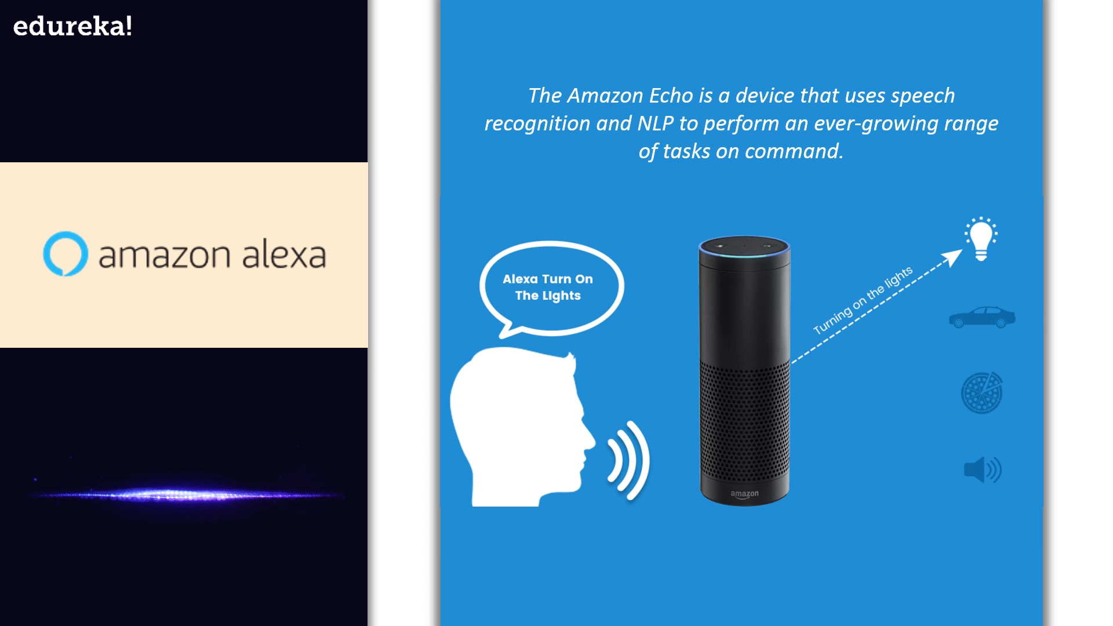
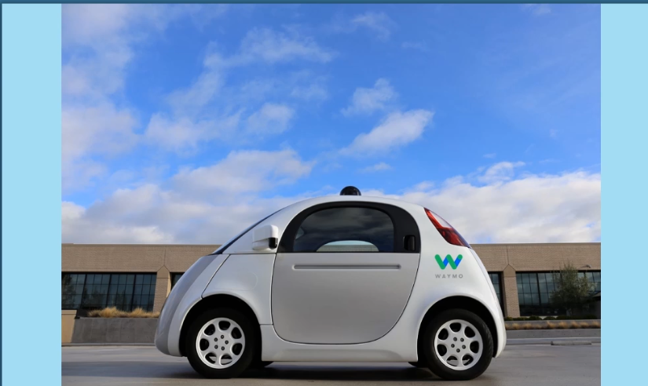
8. AI IN CHATBOTS
7. AI IN AUTONOMOUS VEHICLES
Amazon Alexa
Waymo
Waymos AI software crunches data from the vehicles’ lidar to produce control signals that operate the driverless vehicle
The Amazon Echo is a device that uses speech recognition and NLP to perform an ever- growing range of tasks on command
Google Assistant
Tesla
Tesla will have fully self-driving cars ready by the end of the year and a “robo taxi” version – one that can ferry pasengers without anyone behind the wheel ready for the streets next year
Google Assistant is designed to have conversations with you in order to complete tasks. It uses AI to process natural language and perform tasks like book appointments and make calls.
Notes:
AI chatbots provide 24/7 customer service.
Powered by NLP (Natural Language Processing) to understand user queries.
Examples:
ChatGPT (conversational AI).
Siri, Alexa, Google Assistant (voice assistants).
Used in e-commerce, banking, healthcare, and customer support.
Self-driving cars use AI for:
Computer vision (detecting objects, pedestrians, traffic signals).
Decision-making in real-time.
Navigation & path planning.
Examples: Tesla Autopilot, Waymo.
Benefits: reduced accidents, efficient transport, driverless delivery.

Slide 18

6. AI IN SPACE EXPLORATION
5. AI IN GAMING
The known AI AEGIS is on the red planet onboard NASA’s current rovers. It is developed to handle autonomous targeting of cameras and choose what to investigate
Astronomers Used I To Sift Through Years Of Data Obtained By The Kepler Telescope To Identify A Distant Eight Planet Solar System
F.E.A.R
Notes:
AI assists in space research and missions:
Analyzing huge data from telescopes & satellites.
Autonomous navigation of rovers (e.g., NASA’s Perseverance Rover).
Predicting spacecraft system failures.
Example: AI-powered robots like CIMON assisting astronauts on ISS.
AI creates realistic NPCs (non-player characters).
Used for game design, difficulty adjustment, and player experience personalization.
Examples:
Chess & Go (AlphaZero).
Smart enemies in FPS and RPG games.
AI also generates procedural worlds and storylines.

Slide 19

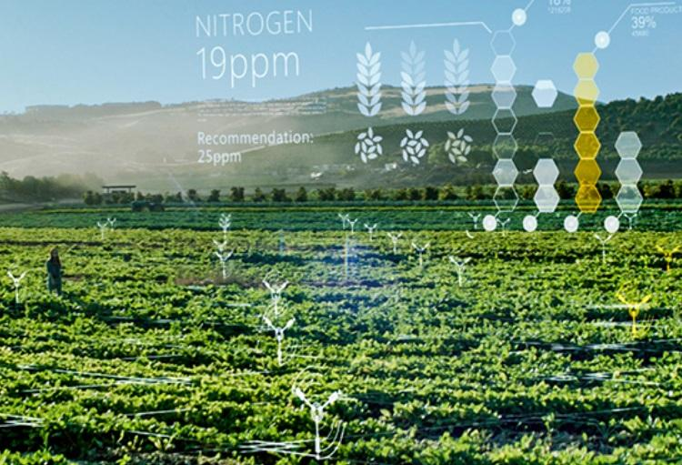

4. AI IN BANKING AND FINANCE
3. AI IN AGRICULTURE
Pantix
Blue river
Notes:
Fraud detection using pattern recognition.
Algorithmic trading (high-speed automated stock trading).
Credit scoring & risk assessment.
Chatbots for customer support in banking apps.
Improves security, efficiency, and decision-making.
AI used for precision farming:
Crop disease detection with computer vision.
Predicting weather & soil conditions.
Smart irrigation & yield prediction.
Example: Drones with AI for monitoring crops.
Helps in increasing productivity and reducing waste.

Slide 20
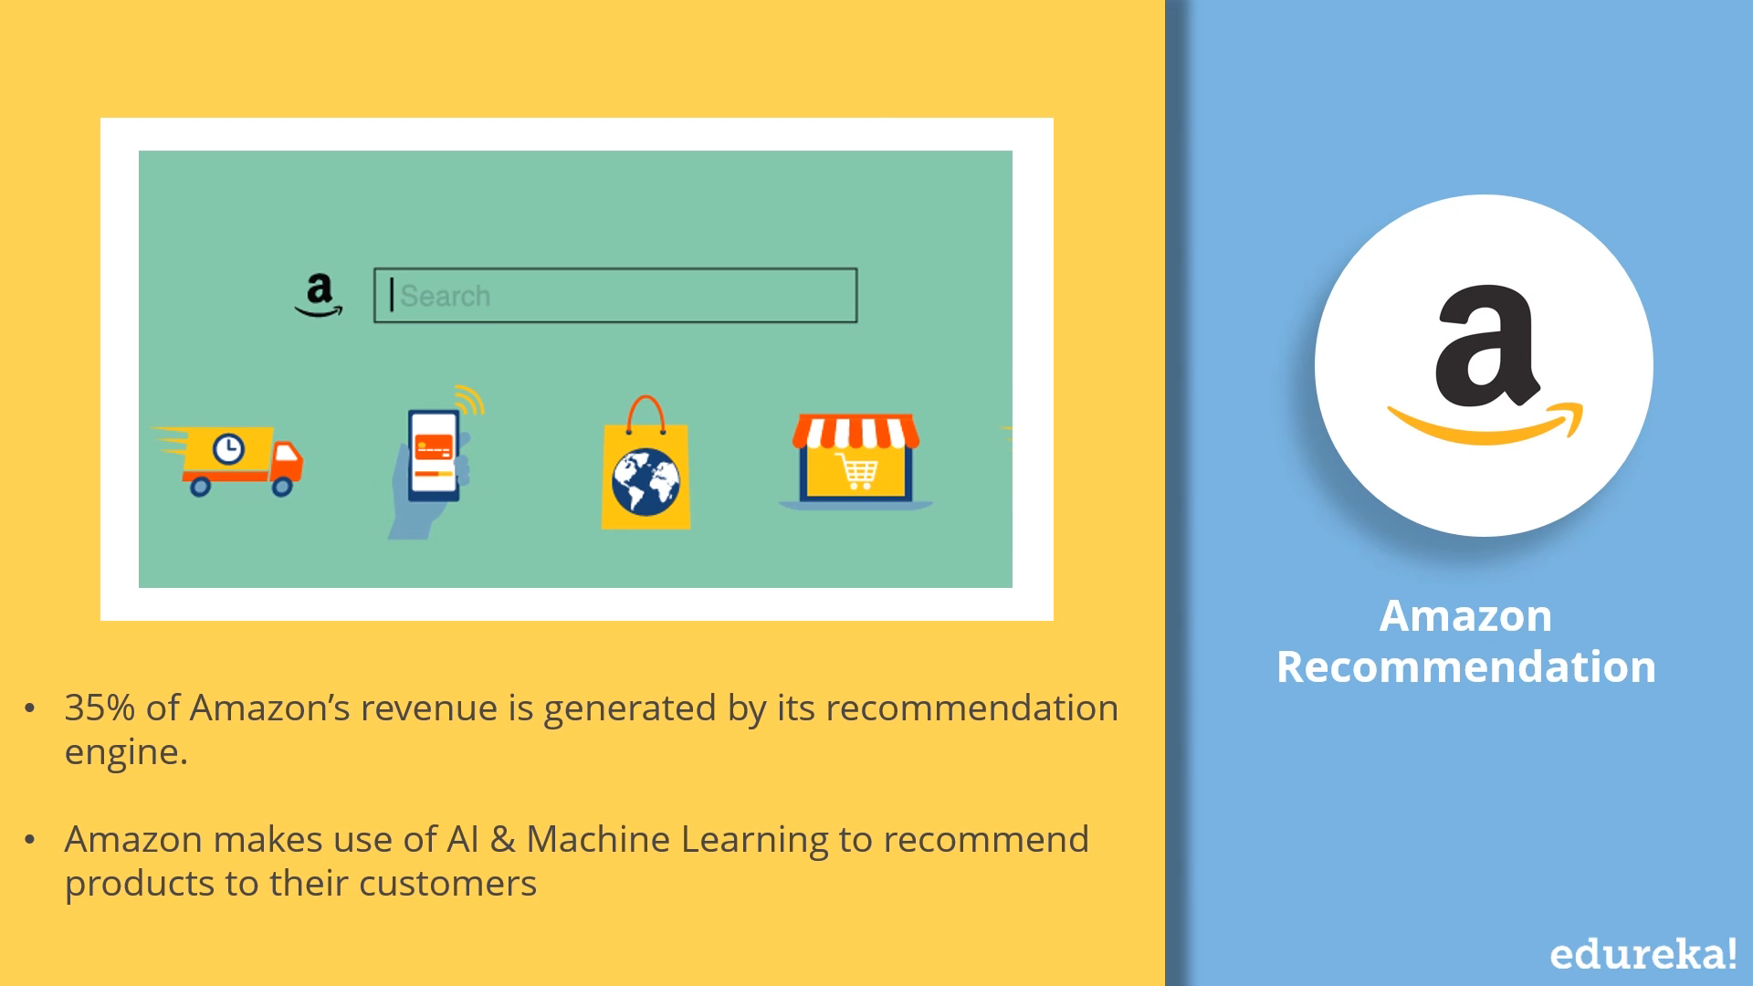
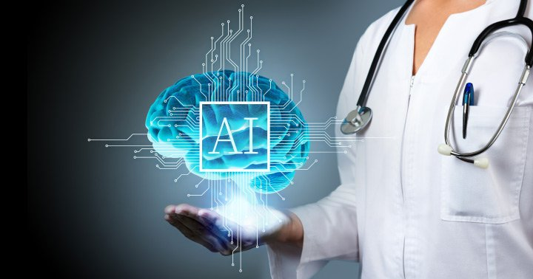
1. AI IN MARKETING
2. AI IN HEALTHCARE
Amazon
IBM Watson
NETFLIX
DeepMind
Notes:
Predictive analytics: forecasting customer behavior.
Personalized ads and product recommendations (Amazon, Netflix).
Sentiment analysis: understanding customer opinions from reviews/social media.
Chatbots for marketing & lead generation.
Enhances customer experience and sales growth.
Medical Imaging: AI detects cancer, tumors, fractures in scans.
Drug discovery: speeds up new medicine development.
Virtual health assistants: monitor patient health.
Example: IBM Watson Health, Google DeepMind in eye disease detection.
AI improves accuracy, speed, and personalized treatment.

Slide 21
T H A N K YOU

